Slide 1
Internet of Things
Dr. Raihan Ul Islam
Associate Professor
Department of Computer Science & Engineering
Room No# AB3-1003 Email: raihan.islam@ewubd.edu
Mobile: +8801992392611

Slide 2
Smart Things
IoT world is made by smart things
A smart thing is a physical object digitally augmented with one or more of the following:
(smart) Sensors (temperature, light, motion, and so on)
(smart) Actuators (displays, sound, motors, and so on)
Computation (can run programs and logic)
Communication interfaces (wired or wireless)

Slide 3
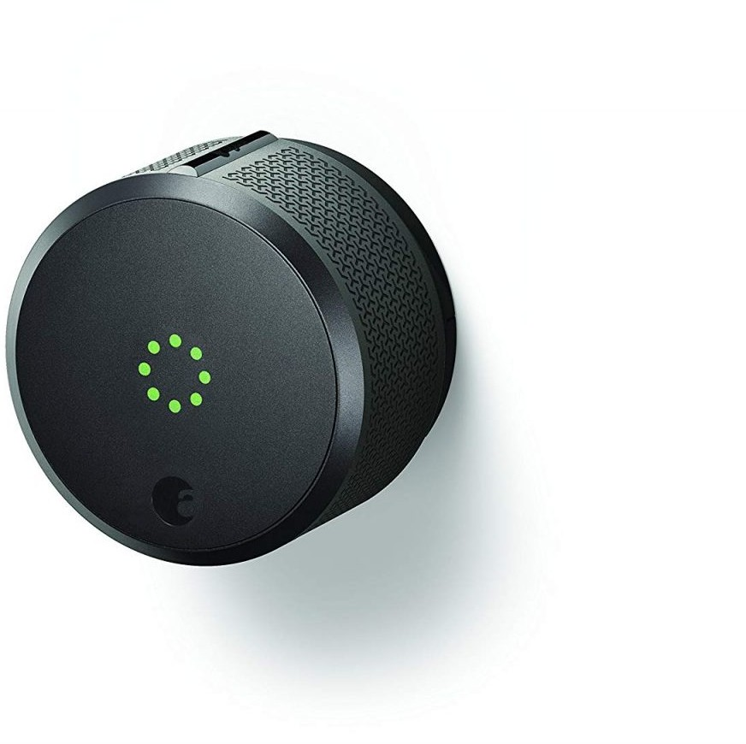
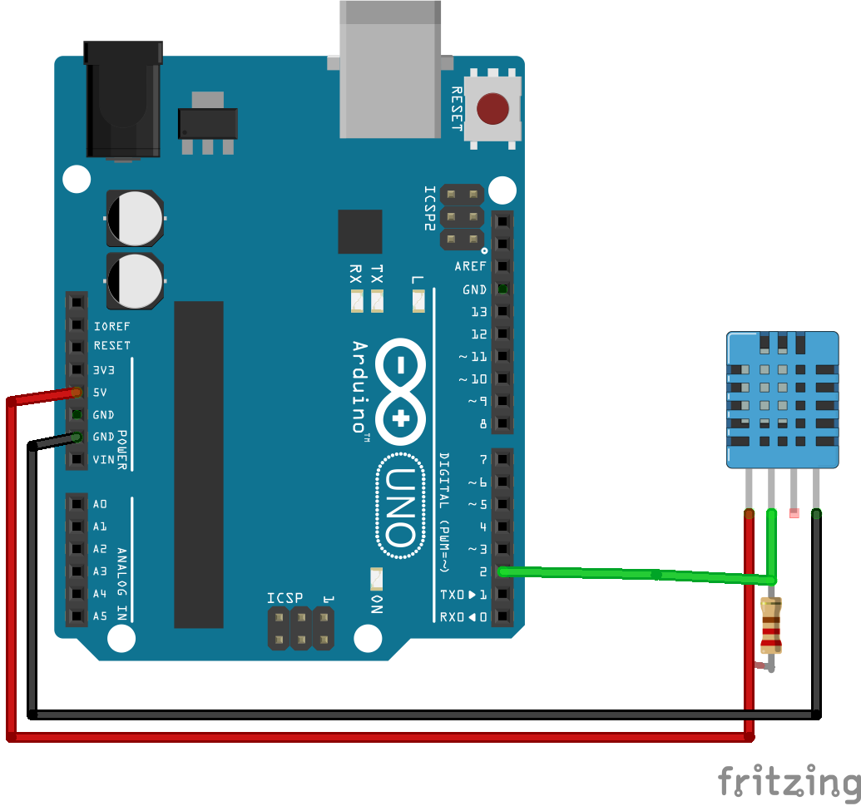
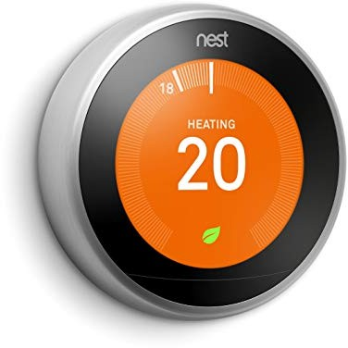
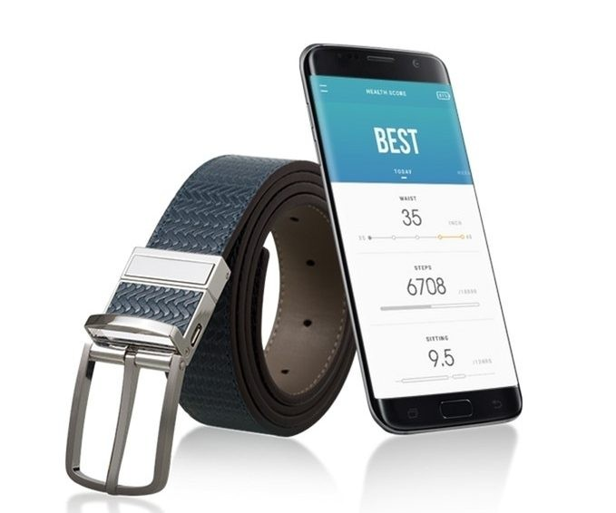
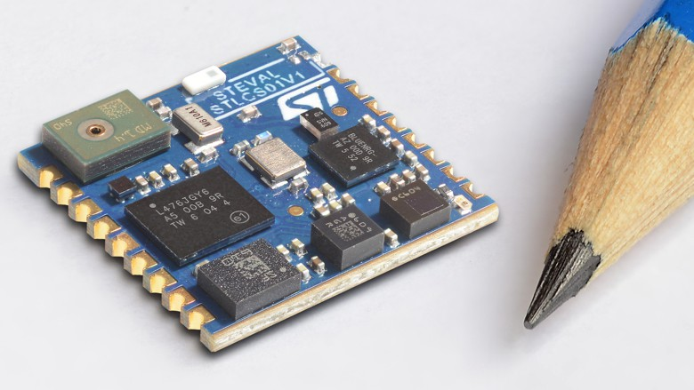
Smart Things

Slide 4

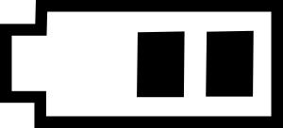



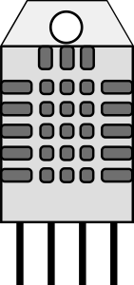
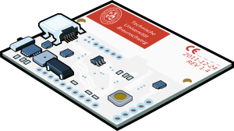

Smart Things
Architecture of a Smart Object
POWER AND POWER MANAGEMENT
SENSORS
PROCESSING UNIT
RADIO TRANSCEIVER

Slide 5
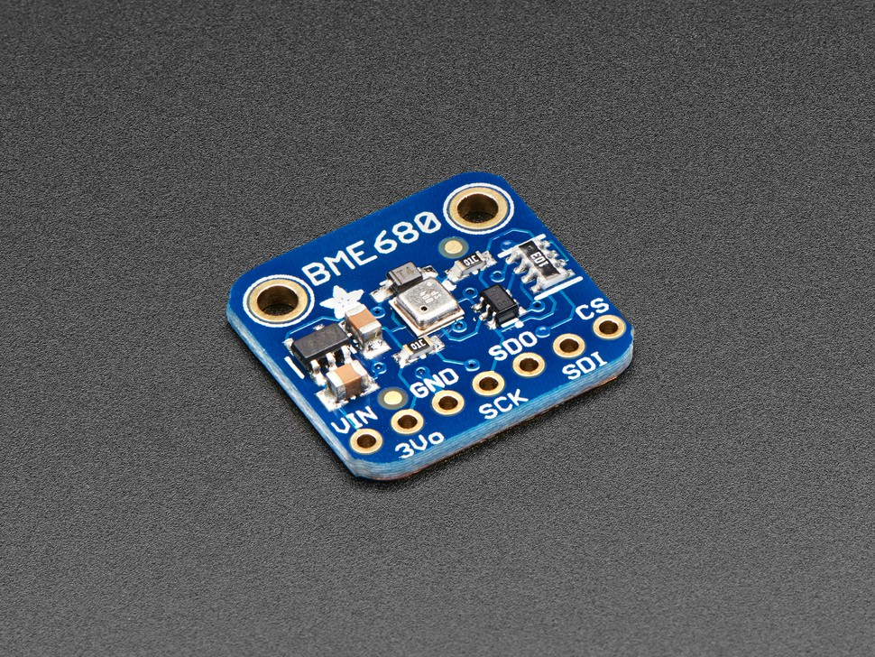
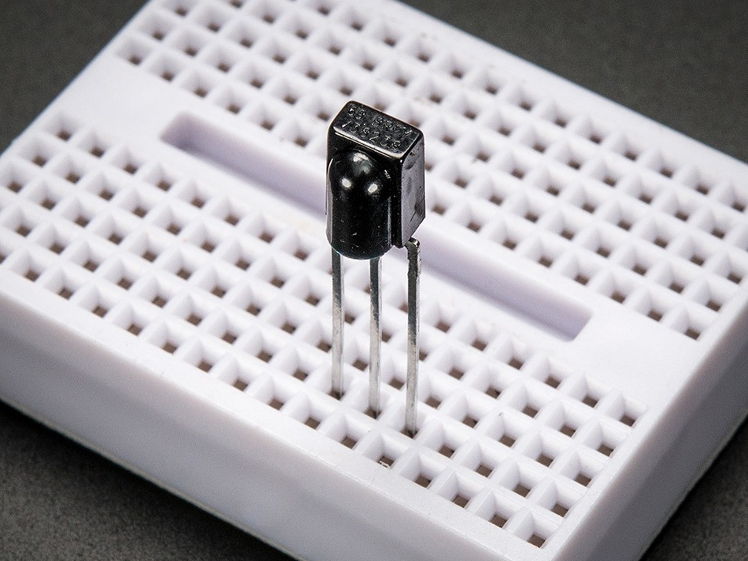
Smart Sensors
A sensor is a device that is able to detect events or changes in its physical environment.
A smart sensor is a device capable of measuring analog inputs from the physical environment and making them digital by using some built-in resources
https://www.adafruit.com/

Slide 6
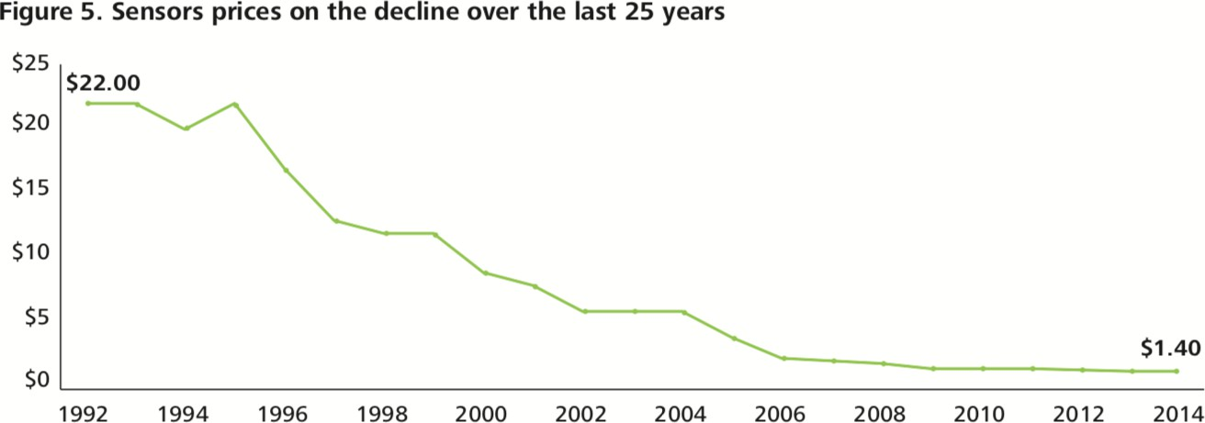

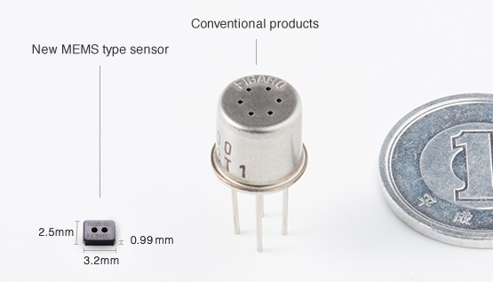
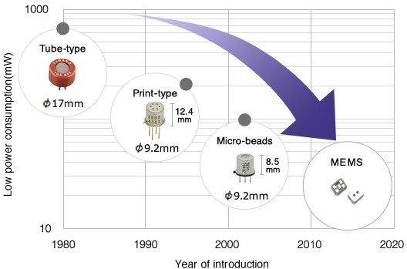

Smart Sensors
[3] https://www.figaro.co.jp/en/technicalinfo/miniaturization.html
Sensors are getting cheaper and cheaper …
Source: [3]
Sensors are getting smaller and smaller …

Slide 7
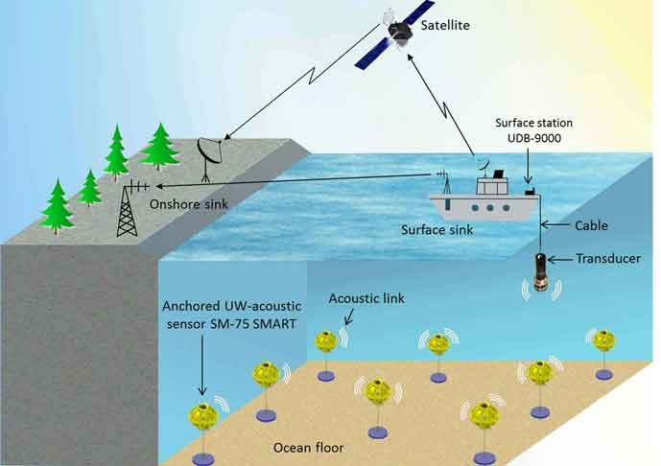
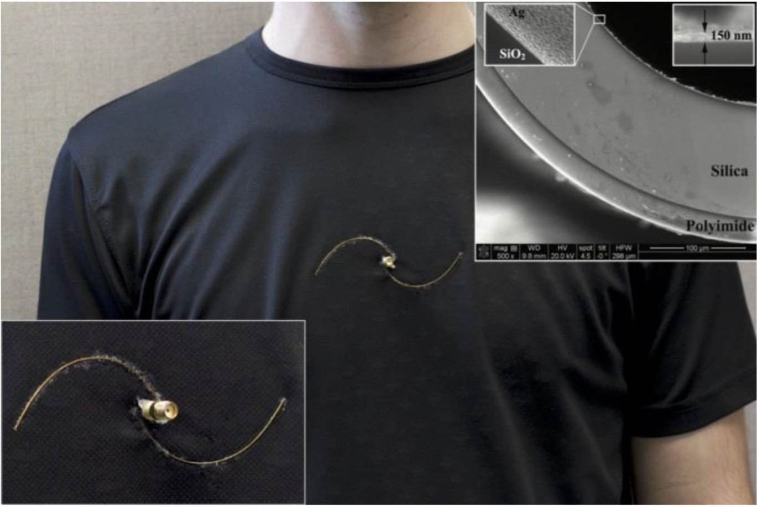
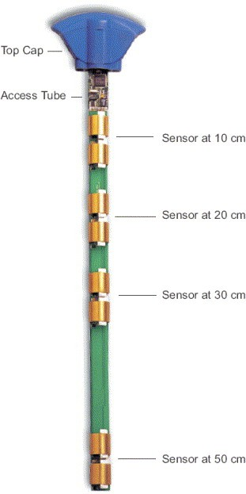
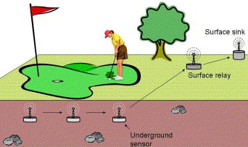
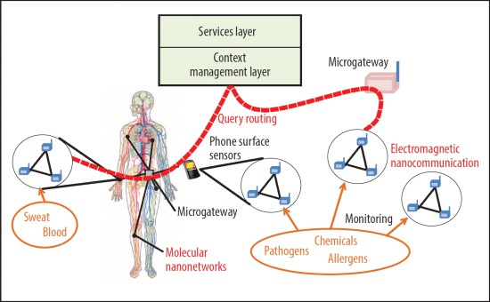

Smart Sensors
UNDERWATER ACUSTIC SENSOR NETWORKS
UNDERGROUND SENSOR NETWORKS
Source: http://www.ece.neu.edu/wineslab/
WEARABLE SENSORS
+ NANOSENSORS

Slide 8

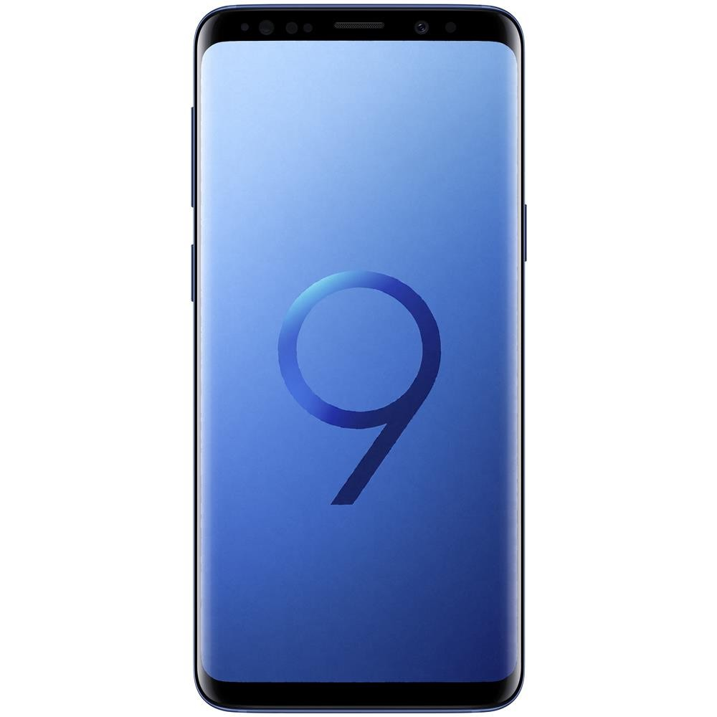


Smart Sensors
[3] https://www.figaro.co.jp/en/technicalinfo/miniaturization.html
Btw, current smartphones embed a multitude of sensors that provide context-aware information about users.
Iris (motion) sensor
Pressure sensor
Accelerometer
Barometer
Gyroscope
Geomagnetic sensor
Hall sensor
HR sensor
Proximity sensor
RGB Light sensor
…
3D Indoor localization
Transportation mode detection
Human activity detection
Human presence detection
Health condition detection
Gesture tracking
…
MINING & LEARNING
TECHNIQUES
SAMSUNG S9

Slide 9

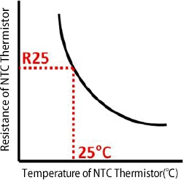


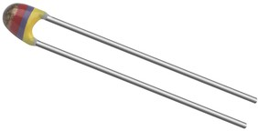
Smart Sensors
Sensors are mostly kinds of transducers, i.e. they convert one form of energy (electrical or not) into another
(electrical or not).
EXAMPLE: TEMPERATURE SENSOR
Negative Temperature Coefficient →Variable resistor that changes its resistance with change of the temperature: the resistance decreases with increase of the temperature.
Source: https://home.roboticlab.eu/

Slide 10

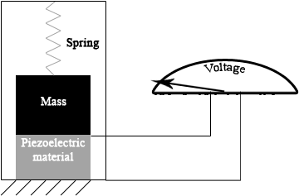
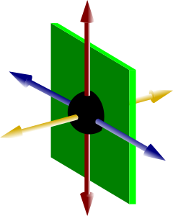
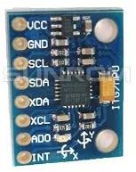
Smart Sensors
Sensors are mostly kinds of transducers, i.e. they convert one form of energy (electrical or not) into another
(electrical or not).
EXAMPLE: ACCELEROMETER SENSOR
Accelerometers are electromechanical devices that sense either static or dynamic forces of acceleration.
Accelerometers can measure acceleration on 1,2 or 3 axes.
Acceleration is derived by the displacement of an internal spring (Inertial Equation), often measured via capacitive plates.

Slide 11
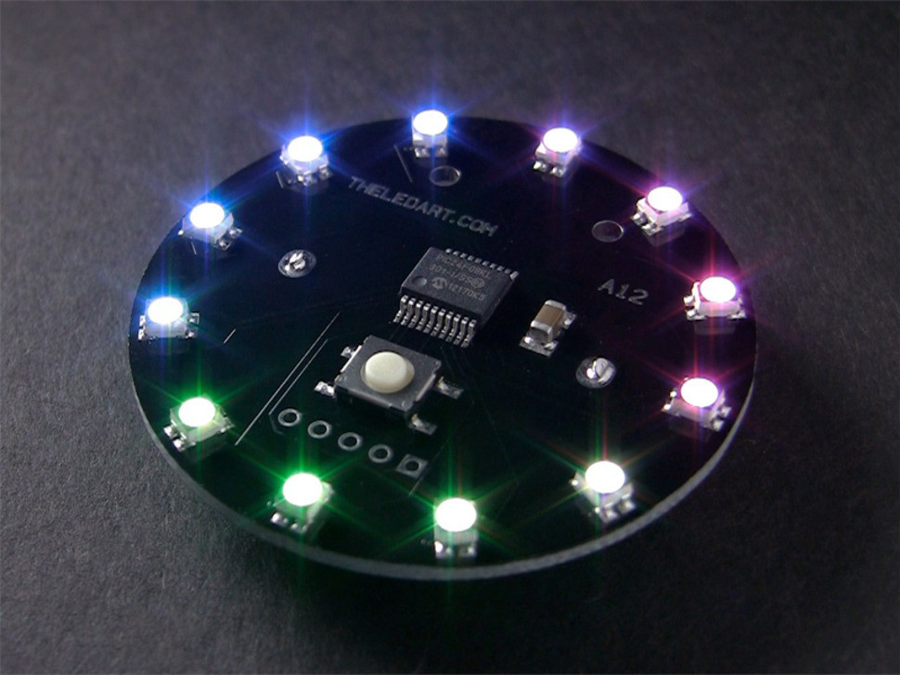
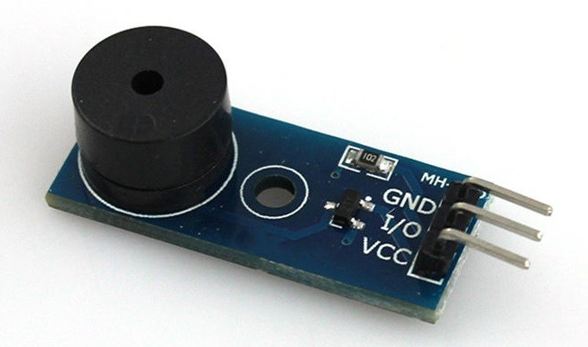
Smart Actuators
https://www.adafruit.com/
An actuator is a device that converts energy into motion.
A smart actuator is a device capable of turning digital inputs into physical actions.
http://www.utteducation.com

Slide 12
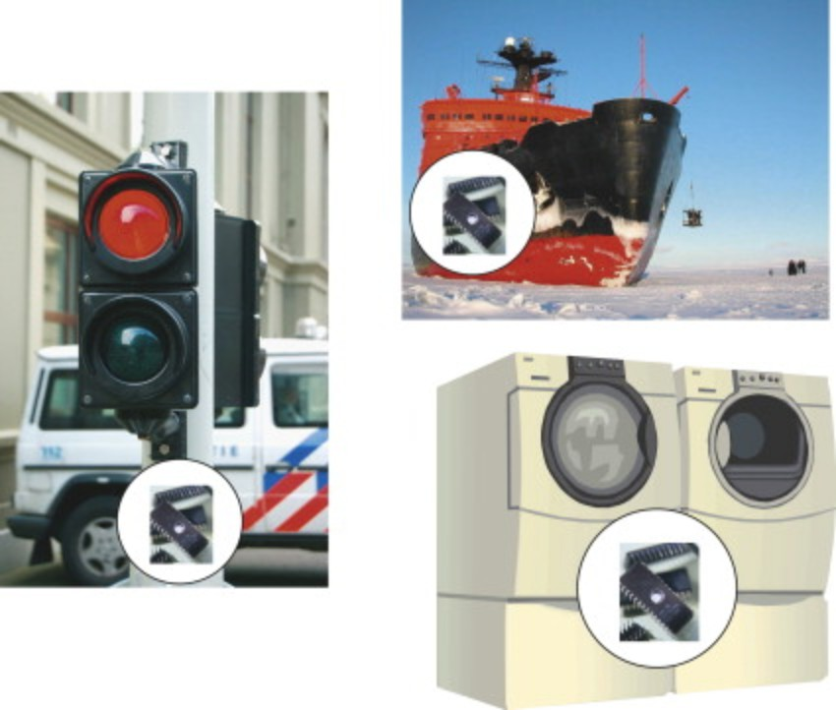
Embedded Systems
[1] https://www.sciencedirect.com/topics/computer-science/embedded-systems
Integrated Microprocessor-based hardware system + software/firmware that is designed to perform a dedicated function/specific purpose.
Some examples:
Industrial systems
Home appliances
Avionics
Network devices (e.g. Routers, switches)
Cache machines
…
Source: [1]

Slide 13

Embedded Systems
[1] https://www.sciencedirect.com/topics/computer-science/embedded-systems
Embedded systems programming often poses some unique challenges (not so common in general-purpose programming):
Real-time vs non-real time systems
Hard-real time vs soft real-time vs firm real-time
WE WILL PROVIDE
Constrained resources (CPU, power battery, …)
Limited memory for data loading and data operations
Limited memory for storing the program source code
Limited multitasking (i.e. thread/process support)
EVIDENCES OF THESE
CHALLENGES THROUGH A DEMO

Slide 14
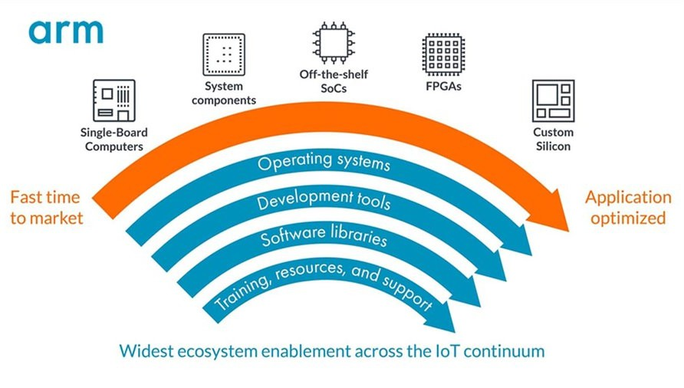
IoT Prototyping Boards
[1] https://community.arm.com/iot/b/internet-of-things/posts/the-arm-internet-of-things-iot-continuum
Hardware platforms that are most commonly used to build prototypes of IoT projects and IoT embedded systems.
Validate the feasibility of a product
Build a proof-of-concept
Do-It-yourself (DIY) projects
Pre-production phase of a new product
Choose hardware components
Deploy and test the software
Source: [1]

Slide 15
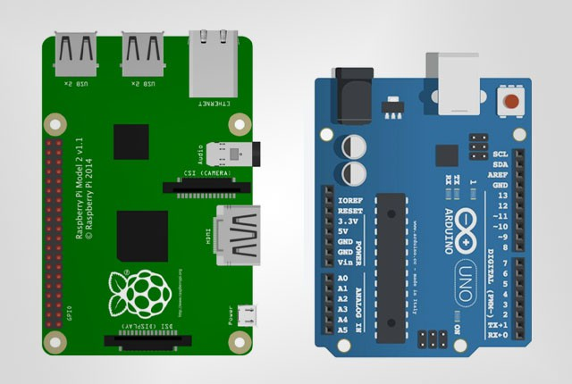
IoT Prototyping Boards
IoT Prototyping boards can be often be classified according to their hardware/software characteristics into two main families:
Microcontroller-based boards
Single-board computers
https://mybroadband.co.za

Slide 16
Microcontroller Boards
It is a system on a chip (SoC) that contains processing cores, RAM and EPROM for the storage of custom programs that are executed on the microcontroller. It is a PCB with added circuitry.
Available on the market since 1975
Often composed by a single CPU + RAM memory + ROM memory (EPROM, EEPROM, …)
Limited processing power (clock speed <100 MHz)
8-bit/16-bit/32-bit architectures
Single program or limited multitasking
No operating system

Slide 17
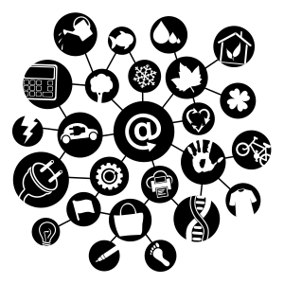

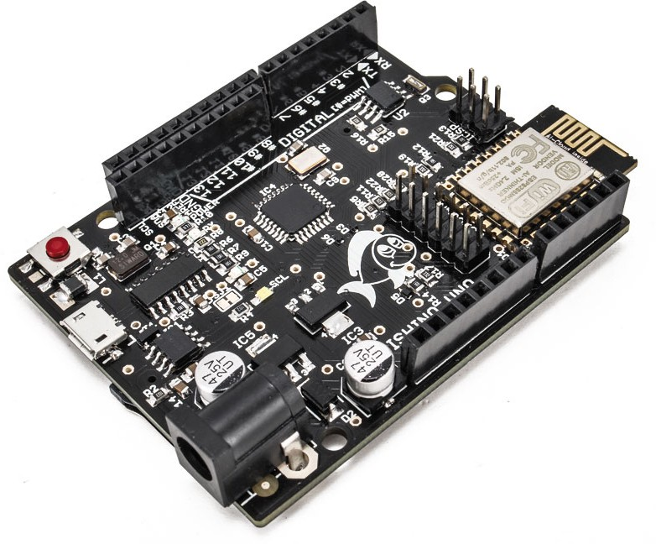
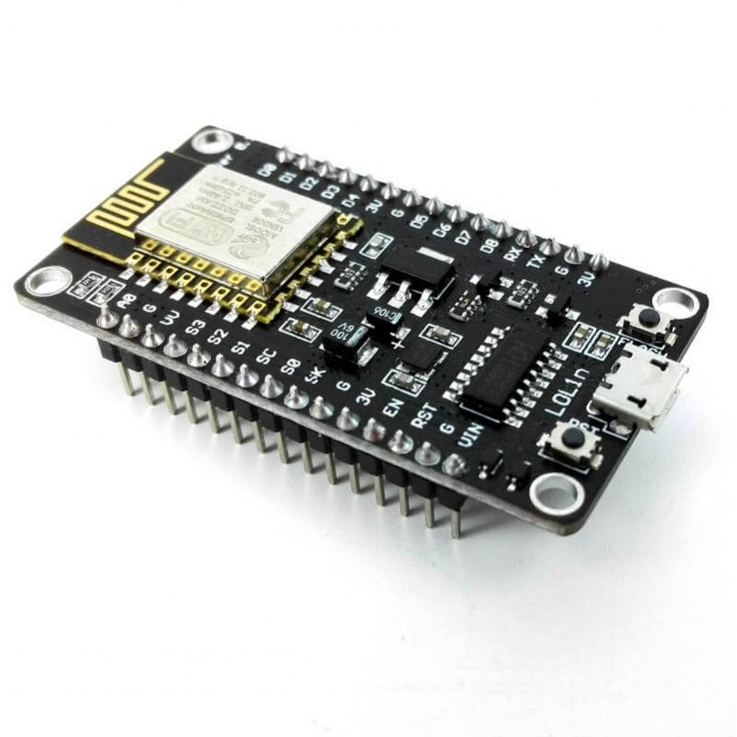
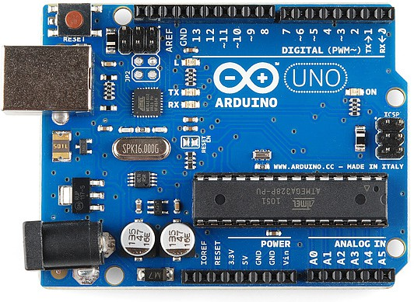
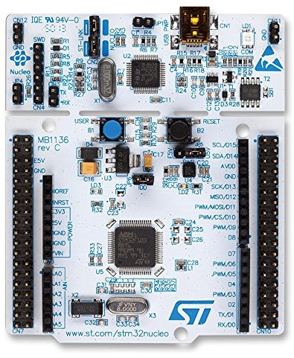


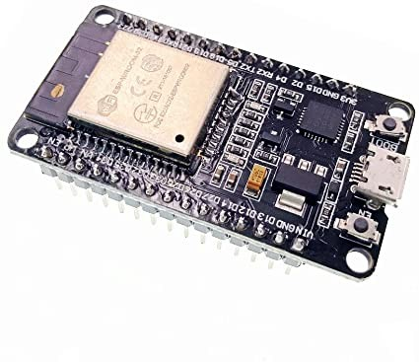

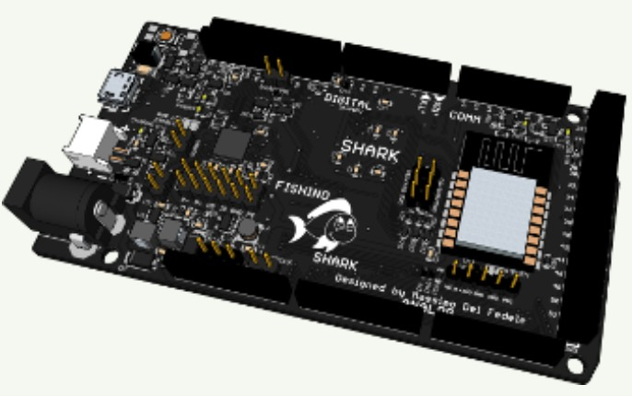

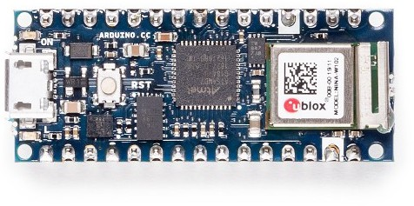



Microcontroller Boards
Some examples (available in our lab):
NODEMCU
FISHINO UNO
ARDUINO UNO
NUCLEO STM32
ESP32
ARDUINO NANO IOT
FISHINO SHARK

Slide 18
Microcontroller Boards
IoT Programming Languages for microcontroller-based boards
C/C++ and variants [C tutorial from W3C community LINK]
LUA [Tutorial: LINK]
Wiring (Arduino, actually a dialect of C/C++) Tutorial: Sistemi Embedded Teoria e Pratica [LINK]
Micropython
Tutorial for different IoT boards [LINK]
Javascript libraries [e.g. CYLON.JS, JOHNNY FIVE]
….

Slide 19
Single board Computers
It is a complete computer on a single circuit board, including microprocessor(s), memory, input/output (I/O) and other features required by a functional computer.
SBC computers typically provide a fan-less, low- power computing solution and a low profile architecture.
https://mybroadband.co.za

Slide 20
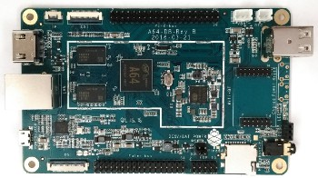
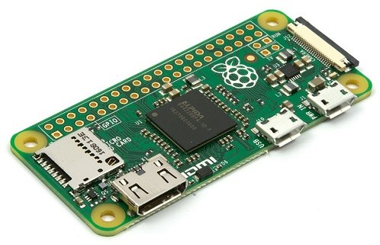


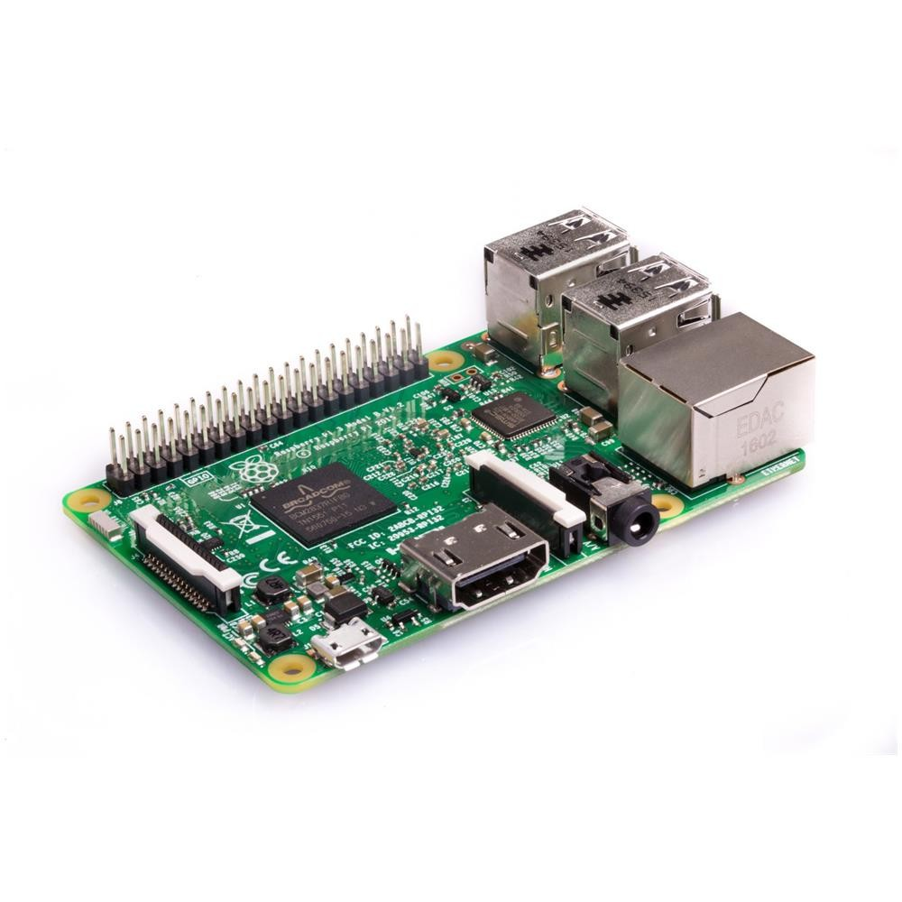
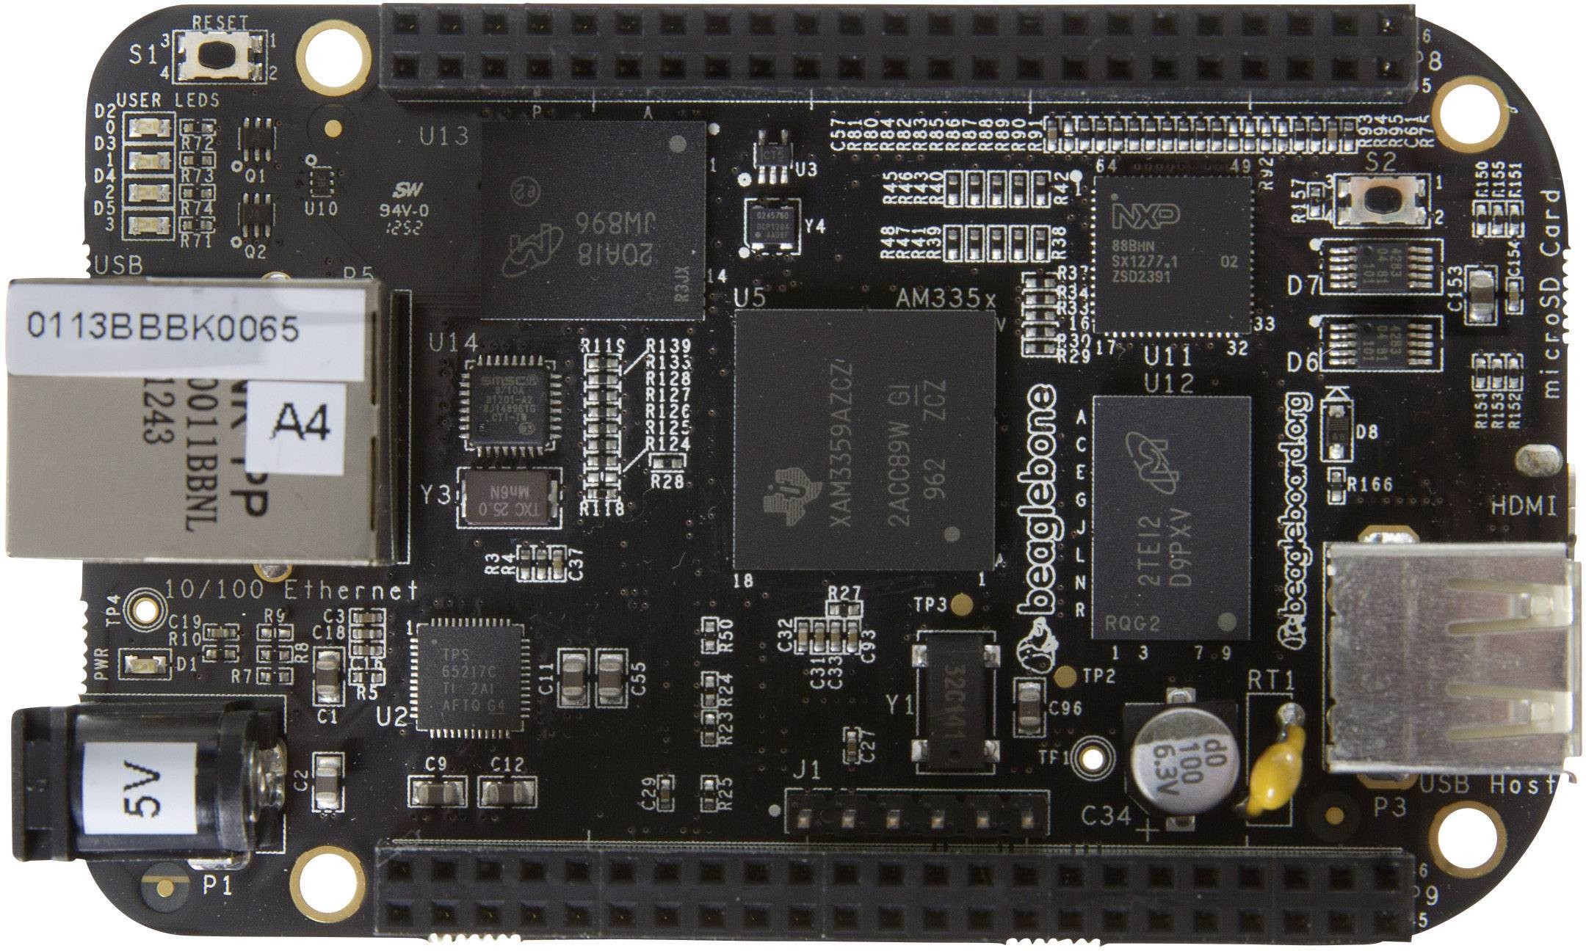


Single board Computers
Some examples (available in our lab):
RASPBERRY PI ZERO
PINE64
RASPBERRY PI 3
BEAGLEBONE

Slide 21

EXAMPLE OF MICRO-CONTROLLER BOARD: ARDUINO UNO

Slide 22

The Arduino Board
Project started in 2003 as a program for students at the Interaction Design Institute (Ivrea, Italy).
IDEA: Create simple, low cost instruments also for non-engineers, aimed to work on digital projects.
Around 700.000 units shipped (in 2013).
Partnership with ARM Holdings (2017).
www.arduino.cc

Slide 23
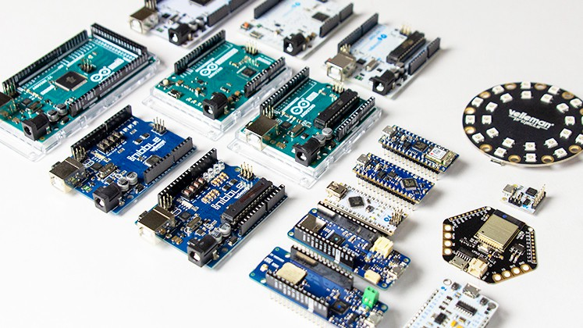
Source: https://www.vellemanformakers.com/the-ultimate-arduino-guide/
The Arduino Board

Slide 24
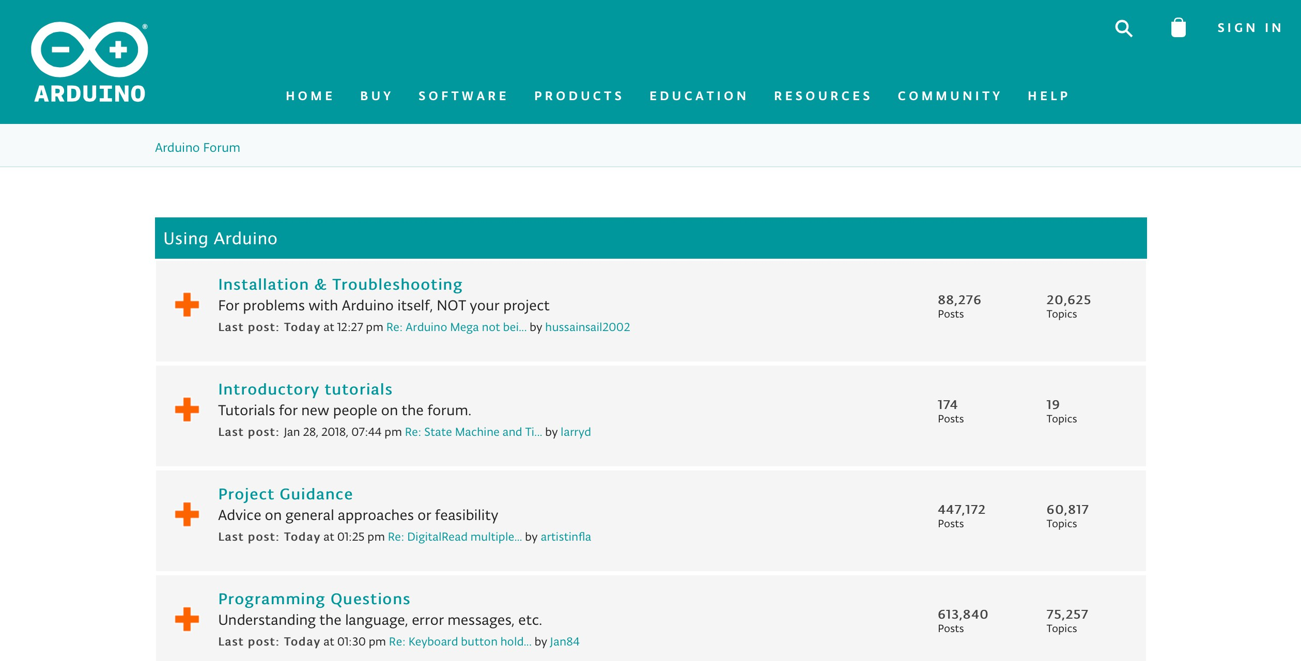
The Arduino Board

Slide 25
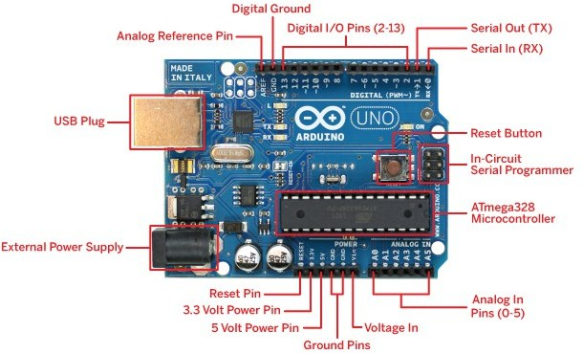
The Arduino Board
Single-board microcontroller.
Sets of digital and analog input/output (I/O) pins that can be interfaced to various expansion boards (shields) and other circuits
http://arduinoarts.com/2011/08/the-arduino-uno-anatomy/

Slide 26
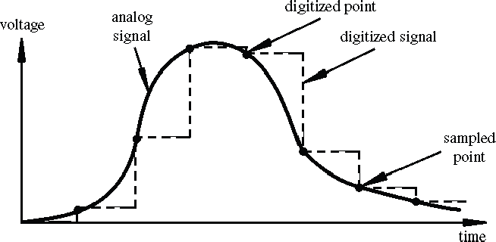
The Arduino Board
Arduino Analog Input
Resolution: the number of different voltage levels (i.e., states) used to discretize an input signal.
Resolution values range from 256 states (8 bits) to 4,294,967,296 states (32 bits).
Arduino uses 1024 states (10 bits).
Smallest measurable voltage change is 5V/1024 or 4.8 mV
Maximum sample rate is 10,000 times a second.

Slide 27
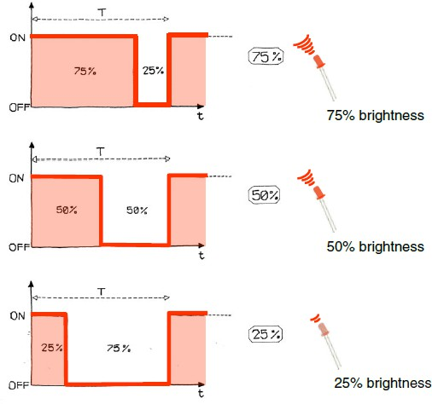
The Arduino Board
Pulse Width Modulation (PWM)
Digital pins can only directly supply 3V or 5V, but they can also pulse the output on and off really fast to produce the same effect of a different voltage supply.
The on-off pulsing is so fast that the connected output device “perceives” the result as a reduction in the voltage.
Image from Theory and Practice of Tangible User Interfaces at UC Berkley

Slide 28
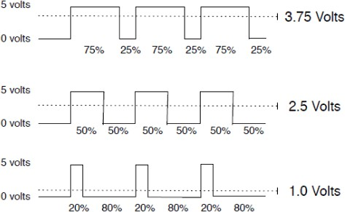
The Arduino Board
output voltage = (on_time / cycle_time) * 5V
Image credit: Tod Kurt
Fixed cycle length; constant number of cycles/sec

Slide 29
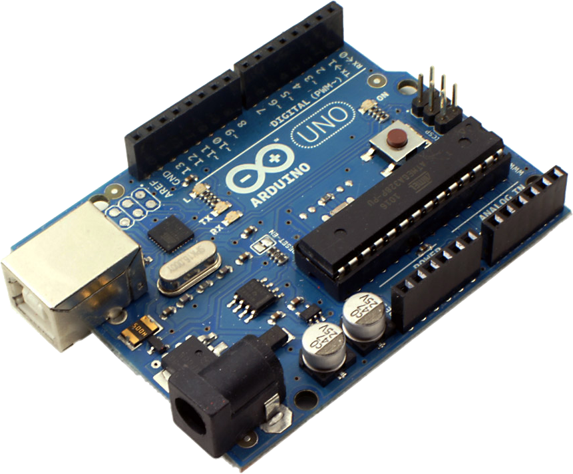


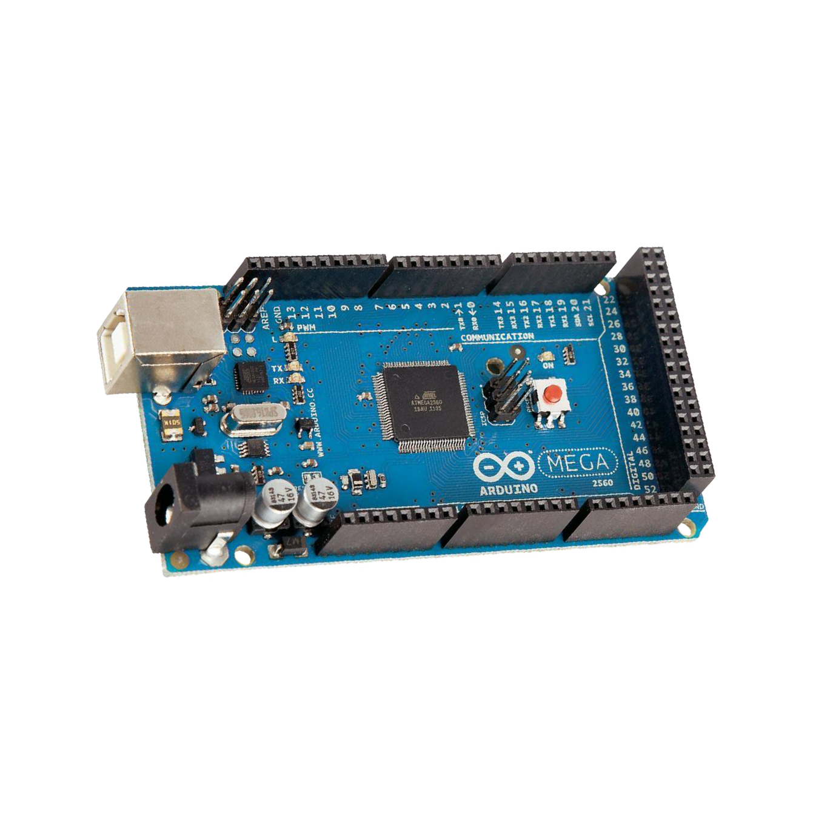
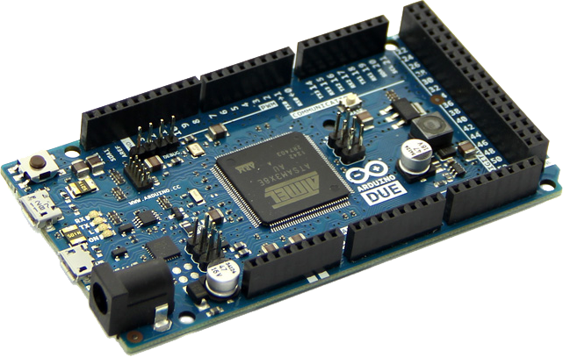




The Arduino Board
 | Arduino Uno | Arduino Mega 2560 | Arduino Due | Arduino Mini | Lily Pad
Processor | ATmega328 | ATmega2560 | AT91SAM3X8E | ATmega328 | ATmega168V ATmega328V
CPU speed[MHz] | 16 | 16 | 84 | 16 | 8
Analog IN/OUT | 6/0 | 16/0 | 12/2 | 8/0 | 6/0
Digital IO/PWM | 14/6 | 54/15 | 54/12 | 14/6 | 14/6
SRAM [KB] | 2 | 8 | 96 | 2 | 1
Flash [KB] | 32 | 256 | 512 | 32 | 16
UART | 1 | 4 | 4 | - | -
Price | ~20€ | ~22€ | ~50€ | ~15€ | ~45€

Slide 30



The Arduino Board
Sketches:
.ino files, .cpp and .h
setup() → initialization of the initial values (pins, variables, etc..)
loop() → infinite repetition of the main code
Development cycle:
Edit
Compile
Upload
Run

Slide 31


The Arduino Board
ARDU
INO IDE

Slide 32
The Arduino Board
#define LED_PIN 13
void setup() {
// initialize digital pin LED.
pinMode(LED_PIN, OUTPUT);
}
void loop() {
digitalWrite(LED_PIN, HIGH); // turn the LED on (HIGH voltage level) delay(1000); // wait for a second digitalWrite(LED_PIN, LOW); // turn the LED off (voltage LOW) delay(1000); // wait for a second
}
CLASSICAL BLINK EXAMPLE

Slide 33
The Arduino Board
boolean (8 bit) - simple logical true/false.
byte (8 bit) - unsigned number from 0-255.
char (8 bit) - signed number from -128 to 127.
unsigned char (8 bit) - same as ‘byte’; if this is what you’re after you should use ‘byte’ instead.
word (16 bit) - unsigned number from 0-65535.
unsigned int (16 bit) - the same as ‘word’. Use ‘word’ for clarity and brevity.
int (16 bit)- signed number from -32768 to 32767.
unsigned long (32 bit)- unsigned number from 0-4,294,967,295.
long (32 bit) - signed number from -2,147,483,648 to 2,147,483,647.
float (32 bit) - signed number from -3.4028235-E38 to 3.4028235-E38. Floating point is not native; the compiler has to jump through hoops to make it work. If you can avoid it, you should.

Slide 34
The Arduino Board
Digital I/O
digitalRead()
digitalWrite()
pinMode()
Analog I/O
analogRead()
analogReference()
analogWrite()
Communication
Serial
stream
Time
delay()
delayMicroseconds()
micros()
millis()

Slide 35

The Arduino Board
Audio
Cloud
Communications
Robotics
Sensors
Storage and memory
Etc..
EXAMPLE of AVAILABLE LIBRARIES
https://playground.arduino.cc/Main/LibraryList

Slide 36

EXAMPLE OF SINGLE-BOARD COMPUTER: RASPBERRY PI

Slide 37

The Raspberry PI Board
Developed in the United Kingdom by the Raspberry Pi Foundation to promote the teaching of basic computer science in schools and in developing countries.
“The Raspberry Pi Foundation is a UK-based charity that works to put the power of digital making into the hands of people all over the world, so they are capable of understanding an shaping our increasingly digital world, able to solve the problems that matter to them, and equipped for the jobs of the future.”
https://www.raspberrypi.org/about/
d

Slide 38

The Raspberry PI Board
Foundation trustee Eben Upton assembled a group of teachers, academics and computer enthusiasts to devise a computer to inspire children.
The computer is inspired by Acorn's BBC Micro of 1981. The Model A, Model B and Model B+ names are references to the original models of the British educational BBC Micro computer, developed by Acorn Computers.

Slide 39

The Raspberry PI Board
Single-board computer with a Broadcom system on a chip (SoC) with an integrated ARM compatible central processing unit (CPU) and on-chip graphics processing unit (GPU).
OPEN+PROPRIETARY (NON TCP/IP) STACKS
L. BONONI, M. DI FELICE, L. SCIULLO, DEPARTMENT OF COMPUTER SCIENCE AND ENGINEERING, UNIVERSITY OF BOLOGNA, ITALY

Slide 40

The Raspberry PI Board
GPIO
40 digital pins
PWM by software
UART
I2C
SPI

Slide 41

 | PiA | PiB | Pi2B | Pi3B | PiZero
Release date | 2014 | 2012 | 2015 | 2016 | 2015
CPU clock | 700 MHz | 700 MHz | 900 MHz | 1.2 GHz | 1 GHz
Cores | 1 | 1 | 4 | 4 | 1
Instruction set | ARMv6 | ARMv6 | ARMv7-A | ARMv8-A | ARMv6
SoC | Broadcom BCM2835 | Broadcom BCM2835 | Broadcom BCM2836 | Broadcom BCM2837 | Broadcom BCM2835
USB ports | 1 | 2 | 4 | 4 | 1 Micro
Memory | 256 MB | 512 MB | 1 GB | 1 GB | 512 MB
Storage | SDCard | SDCard | Micro SD card | Micro SD card | Micro SD card
Ethernet | None | 100 Mbit/s | 100 Mbit/s | 100 Mbit/s | None
Wifi | None | None | None | 802.11n | None
Bluetooth | None | None | None | 4.1 | None
GPIO | 26 pins | 26 pins | 40 pins | 40 pins | 40 pins
Alimentation | 5V/1 Amp | 5V/1 Amp | 5V/2 Amp | 5V/2,5 Amp | 5V/2 Amp
cost | 20$ | 35$ | 35$ | 35$ | 5$
The Raspberry PI Board

Slide 42
The Raspberry PI Board
Software Distro
Linux Distros:
Raspbian (Debian) and Ubuntu (at least ARMv7)
Archlinux, Fedora, Gentoo, etc..
Volumio, OpenElec
RISC OS
Others:
Windows 10 IoT Core Edition (at least ARMv7)
Android

Slide 43
The Raspberry PI Board
Raspberry vs Arduino Boards
Advantages of Arduino:
Robustness (no OS on it)
Low Power Consumption
Price
Advantages of Raspberry:
Powerfulness (multitasking)
Networking on board
All the OS functionalities

Slide 44
The Raspberry PI Board
Raspberry vs Arduino Boards
Choose Arduino if:
You want to learn basics of electronics
You have a simple project to deploy
Your projects does not involve so much software
Choose Raspberry if:
You have a complex project, with a lot of software involved
You need OS functionalities
Networking is involved

Slide 45

I2C Protocol
I2C, or Inter-Integrated Circuit, is a simple communication protocol often used in embedded systems as a way to transfer data between a master (or multiple masters) and a single slave (or multiple slaves) device.
It is a bidirectional two-wire serial bus.
It uses serial clock (SCL) and serial data (SDA) wires to send and manage data bit by bit between devices connected to the bus.
In I2C operations, the master controls the exchange of data between the devices. A master device will signal to a slave in order to send data or request a response. To accomplish this, all slave devices must have a unique address that is included in the I2C message.
I2C is considered to be synchronous, meaning it operates using a serial clock.
The standard data transfer rate of the I2C protocol is 100 kbps, although data speeds of up to 5 Mbps are possible with I2C devices configured in "fast mode" or "ultra-fast mode".
https://www.totalphase.com/blog/2021/12/i2c-vs-spi-vs-uart-introduction-and-comparison-similarities-differences/?srsltid=AfmBOoraf5NQIN_hvbYhiE9yxK_jCE4CgF8x9zOqBISuC56R2xoLhaTP

Slide 46

SPI Protocol
SPI, or Serial Peripheral Interface, is a serial communication protocol often used in embedded systems for high-speed data exchanges between devices on the bus.
It operates using a master-slave paradigm that includes at least four signals:
a clock (SCLK)
The SCLK signal is generated by the master device for synchronization
a master output/slave input (MOSI)
Used for data exchange
a master input/slave output (MISO)
used for data exchange
a slave select (SS) signal.
The master pulls low on a slave's SS line to select a device for communication.
SPI communication supports full-duplex communication.
Data speeds in excess of 100 MHz have been achieved.

Slide 47

UART

Slide 48
Thank you

